Slide 1
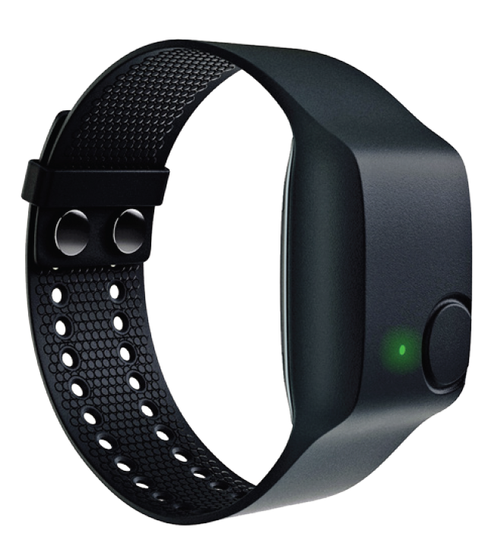
Physiological wristband
Empatica e4
R. Neveu, July 2016

Slide 2
Data quality check: method (1)
Method:
Recording of SCR, heart rate (plethysmogram sensor) and skin temperature with Biopac MP 36R and e4 simultaneously
Synchronization: with UTC for both devices
Task: 10 deep breath without hand movements (Biopac and e4 recording)
Biopac sensors:
SCR: one located on the palm (3.9 Hz) and one located on the inner side of the wrist (3.9 Hz)
Plethysmogram: at the extreme part of the finger (62.5 Hz)
Temperature: under the wrist band of the e4 (3.9 Hz)

Slide 3
Data quality check: method (2)
Analyses:
Average of the 10 deep breath over a window of 7 seconds after the trigger (SCR, heart rate, temperature)
Removing tonic component of the signal: subtracting the mean over the 7s window for each deep breath independently (SCR, heart rate, temperature)
Cross correlation (heart rate) and shift in time (heart rate)
Rescale of amplitude (heart rate)
Pearson correlation for each deep breath over the 7s time window

Slide 4
Data quality check: Heart rate results (1)
Example of backward shift (trial 5, highest shift)

Slide 5
Data quality check: Heart rate results (2)
Example of forward shift (trial 9, highest shift)

Slide 6
Data quality check: Heart rate results (3)
Overall good correlation over the 7s time window (mean (SD)): 0.68 (0.05)
Overall low shift (mean (SD)): 527 ms (404 ms)
However, shift might vary substantially from -875 ms to 750 ms
Heart rate (number of pics per minutes): 2.14% of error between MP 150 and e3
(see https://support.empatica.com/hc/en-us/articles/200293658-Have-you-done-comparative-studies-or-validation-of-the-heart-rate-obtained-from-the-E3-)

Slide 7
Data quality check: SCR results (1)
Substantial difference in SCR level between palm and wrist with Biopac (units in micro siemens, mean and SEM reported):
Poor correlation between the two signals (median [min – max]):
0.47 [-0.02 – 0.99]

Slide 8

Data quality check: SCR results (2)
E4 captures SCR response but substantial difference between variations in amplitude of the SCR response with Biopac (units in micro siemens after detrending, mean and SEM reported):
Good correlation between the two signals (median [min – max]):
0.83 [0.5 – 0.97]

Slide 9
Data quality check: SCR results (3)
Additional measures with 4 other participants over variable durations (~6 minutes to ~5 hours) with e4 only:
Participant | Mean (SD) of EDA (micro Siemens)
Subject 1 deep breath without movement | 0.20 (0.06)
Subject 2 deep breath without movement | 0.46 (0.05)
Subject 3 deep breath without movement | 0.15 (0.01)
Subject 3 deep breath with movement | 0.53 (0.26)
Subject 4 long recording without deep breath | 0.41 (0.59)
Subject 4 long recording without deep breath | 0.36 (0.47)
Subject 4 long recording without deep breath | 1.23 (1.99)
Subject 4 long recording without deep breath | 0.50 (0.81)
Subject analyzed on slides 7 and 8 | 4.71 (1.77)

Slide 10
Data quality check: SCR results (3)
Comparison with Biopac for subject 1 (10 deep breaths, units in micro siemens after detrending, mean and SEM reported)):
It is more difficult to capture SCR response at the wrist even with Biopac
https://support.empatica.com/hc/en-us/articles/203005295-Have-you-done-comparative-studies-or-validation-on-Electrodermal-activity-sensor-

Slide 11
Data quality check: temperature results (1)
Substantial difference between e4 and Biopac for the variations in amplitude of the temperature (units in °C after detrending, mean and SEM reported):
Poor correlation between the two signals (median [min – max]):
-0.22 [-0.87 – 0.37]

Slide 12
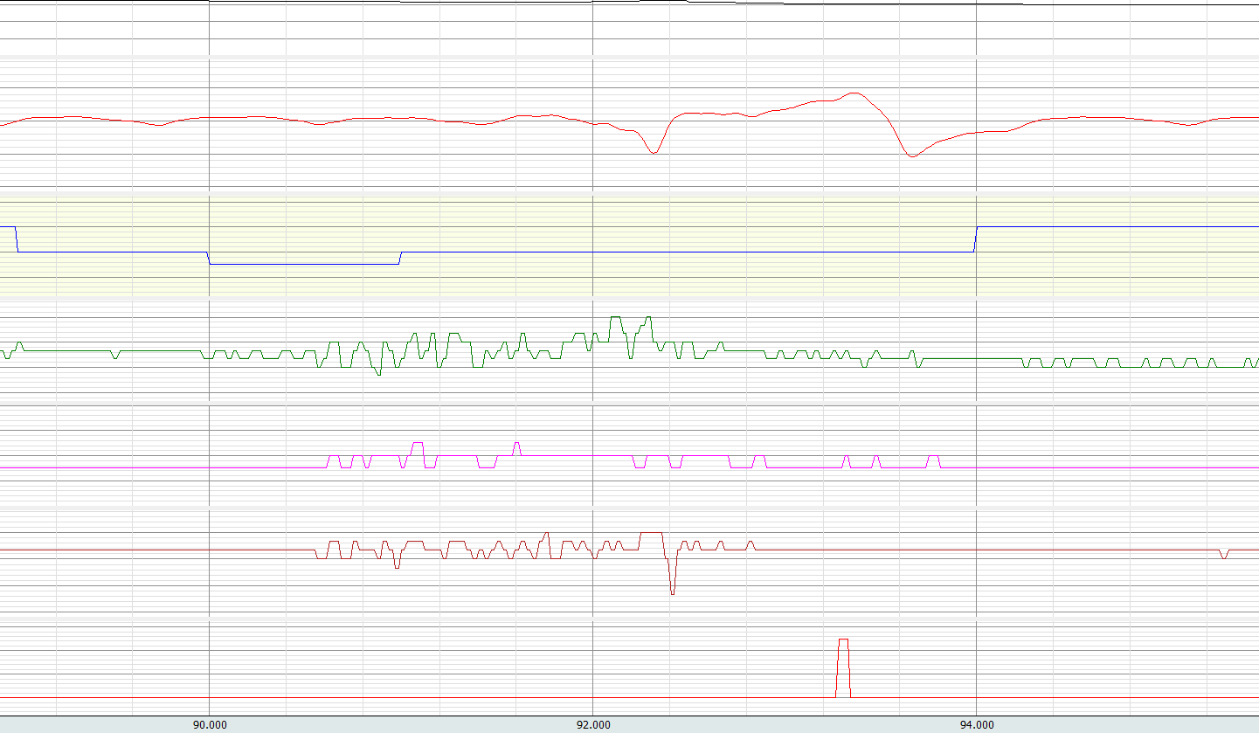
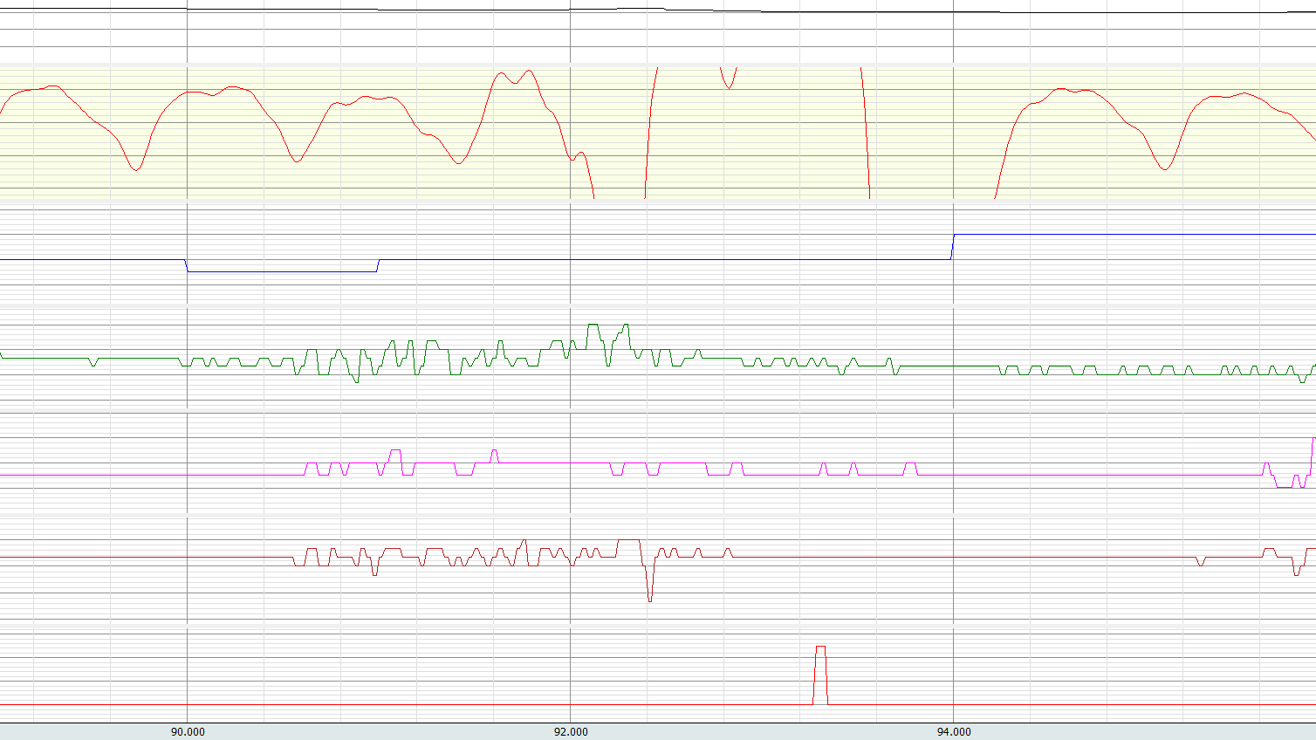
Data quality check: triggers (1)
Substantial impact of the button press over the signal (here heart rate):

Slide 13
Data quality check: method (3)
Method:
Recording with e4 only for a few minutes
Synchronization: with e4 button only
Task 1: 20 high amplitude arm movements vertically
20 high amplitude arm movements vertically
after a flip of 90° of the wrist
20 rotations of the wrist
20 flexions of the legs with the wrist fixed
Task 2: lay on the table without wearing for a few minutes then flipped by 90° according to each hyperplan of the 3D space
Analyses:
Computation of means and SD over period defined between two consecutive time stamps

Slide 14
Data quality check: acceleration results (1)
Task 1 (mean (SD) are reported, units in 1/64g, g=9.81 m.s^-2):
 | X | Y | Z | Module | Heart rate (beats per minutes)
Vertical arm movement | -0.58 (31.85) | -56.32 (61.65) | 24.4 (74.24) | 107 (51.23) | 73.11 (1.32)
Vertical arm movement (wrist flipped by 90°) | 30.13 (75.17) | -54.52 (53.79) | 6.06 (34.18) | 106.8 (47.09) | 79.55 (2.489)
Wrist rotation | 26.58 (71.61) | 4.915 (11.24) | -3.445 (59.58) | 90.18 (37.38) | 87.17 (1.285)
Leg flexions | -2.024 (7.437) | -0.7613 (12.29) | 60.84 (6.758) | 62.54 (6.835) | 89.22 (0.3059)
Task 2 (mean (SD) are reported, units in 1/64g, g=9.81 m.s^-2):
 | X | Y | Z
Session 1 device A00888 | -2.648 (0.4779) | 64 (0) | 6.634 (0.4819)
Session 2 device A00888 | -64.03 (0.1793) | 0.04859 (0.2151) | 6.429 (0.4951)
Session 3 device A00888 | -0.001255 (0.04573) | -0.9967 (0.05777) | -62.04 (0.2017)
Session 1 device A00AC4 | -2 (0) | 64 (0.03344) | 8.086 (0.2807)
Session 2 device A00AC4 | -65 (0) | 1.212 (0.409) | -7.001 (0.02925)
Session 3 device A00AC4 | -0.9102 (0.2859) | 0.9996 (0.02065) | -63 (0)

Slide 15
Data quality check: method (4)
Method:
Recording with 2 e4 only for 10 periods of a little bit more than one minute
Task: no movement
Setting: resynchronization of the 2 e4 immediately before the test + one e4 on the left wrist and one e4 on the right wrist. Then same thing with the two e4 on the same arm
Analyses:
Two by two correlations between e4 for each signal

Slide 16
Data quality check: multiple devices results (1)
Setting 1: opposite arms (mean (SD) are reported)
 | Correlation
Acceleration X | 0.015 (0.14)
Acceleration Y | 0.11 (0.32)
Acceleration Z | 0.007 (0.029)
SCR | 0.86 (0.14)
Heart rate | -0.54 (0.059)
Temperature | 0.28 (0.53)
Setting 2: same arms (mean (SD) are reported)
 | Correlation
Acceleration X | 0.58 (0.38)
Acceleration Y | 0.62 (0.35)
Acceleration Z | 0.51 (0.42)
SCR | 0.7 (0.35)
Heart rate | -0.35 (0.2)
Temperature | 0.09 (0.35)

Slide 17
Data quality check: method (5)
Method:
Recording with e4 only for several hours over several days
Synchronization: with e4 button only
Analyses:
Computation of means, SD, median, min, max over each period defined between two consecutive time stamps

Slide 18
Data quality check: real life test (1)
Skin conductance (unit in micro siemens):
Task | Mean | SD | Median | Min | Max
Start meetings with students | 0.24 | 0.07 | 0.25 | 0.00 | 1.40
Start walking + PI meeting | 1.00 | 0.93 | 0.64 | 0.00 | 5.04
Start move, heat hands in toilets, mails | 0.46 | 0.26 | 0.40 | 0.02 | 2.11
Start biking (cold) | 0.08 | 0.12 | 0.03 | 0.00 | 0.72
Start cooking (hot) + eating + play with Elsa | 0.13 | 0.04 | 0.13 | 0.00 | 0.67
Start reading with Elsa (warm be cover) | 0.21 | 0.06 | 0.23 | 0.08 | 0.33
Start mails to the end of recording | 0.27 | 0.04 | 0.27 | 0.13 | 0.67

Slide 19
Data quality check: real life test (2)
Heart rate (unit in beats per minute):
Task | Mean | SD | Median | Min | Max
Start meetings with students | 77 | 8 | 76 | 53 | 113
Start walking + PI meeting | 77 | 11 | 76 | 57 | 127
Start move, heat hands in toilets, mails | 81 | 13 | 77 | 57 | 120
Start biking (cold) | 97 | 14 | 95 | 73 | 125
Start cooking (hot) + eating + play with Elsa | 88 | 14 | 85 | 68 | 141
Start reading with Elsa (warm be cover) | 77 | 5 | 75 | 68 | 91
Start mails to the end of recording | 78 | 8 | 76 | 61 | 110

Slide 20
Data quality check: real life test (3)
Temperature (unit in °C):
Task | Mean | SD | Median | Min | Max
Start meetings with students | 33.8 | 1.6 | 33.7 | 30.3 | 35.9
Start walking + PI meeting | 33.7 | 0.8 | 33.6 | 31.7 | 35.6
Start move, heat hands in toilets, mails | 34.0 | 1.1 | 34.0 | 31.3 | 35.5
Start biking (cold) | 31.4 | 2.7 | 31.8 | 27.0 | 35.4
Start cooking (hot) + eating + play with Elsa | 32.8 | 1.8 | 33.4 | 27.1 | 35.2
Start reading with Elsa (warm be cover) | 33.5 | 1.4 | 32.8 | 31.7 | 36.1
Start mails to the end of recording | 35.6 | 0.1 | 35.6 | 35.1 | 35.9

Slide 21
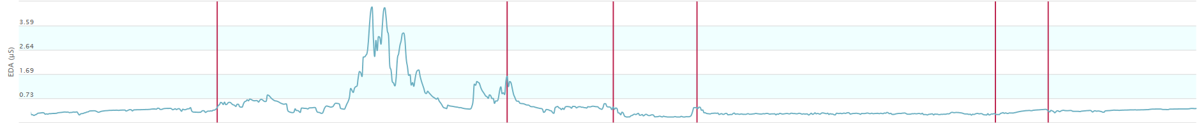
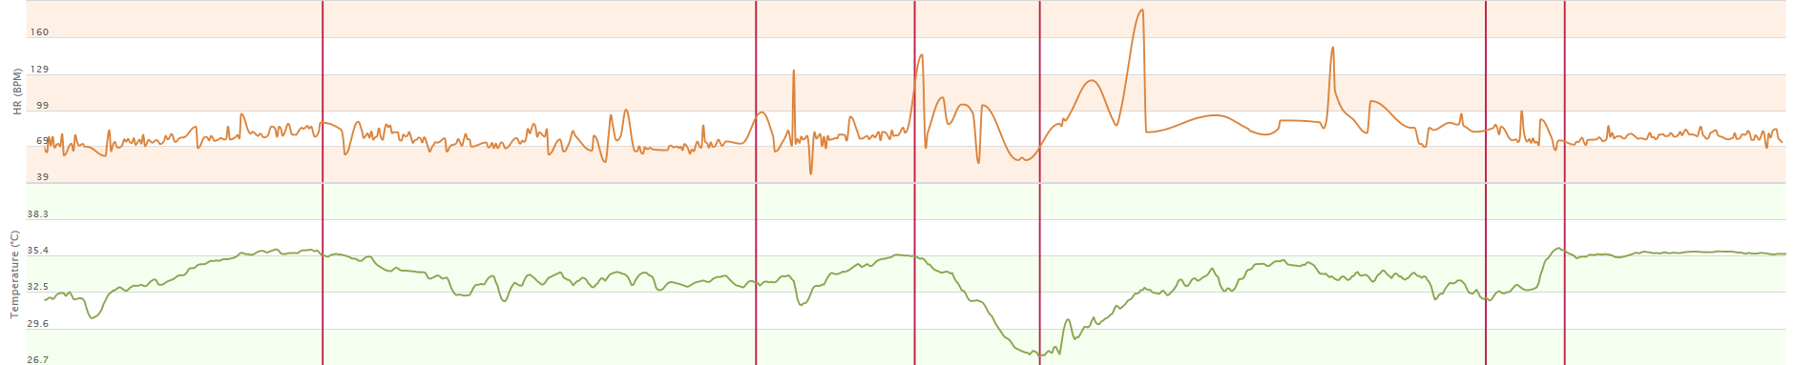
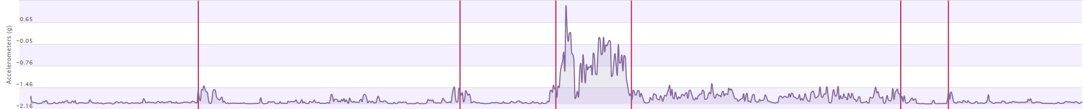
Data quality check: real life test (4), session 1
Start move, heat hands in toilets, mails
Start cooking (hot) + eating + play with Elsa
Start meetings with students
Start walking + PI meeting
Start biking (cold)
Start reading with Elsa (warm be cover)
Start mails to the end of recording

Slide 22
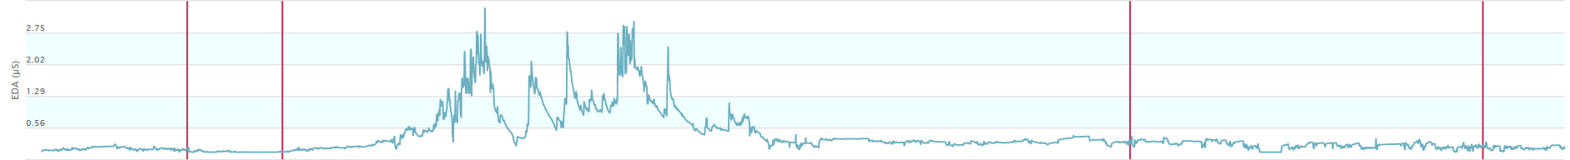
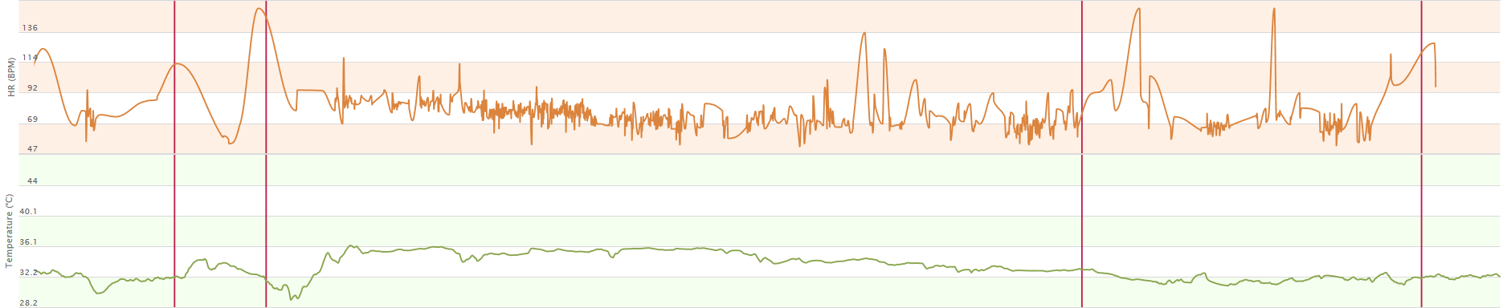
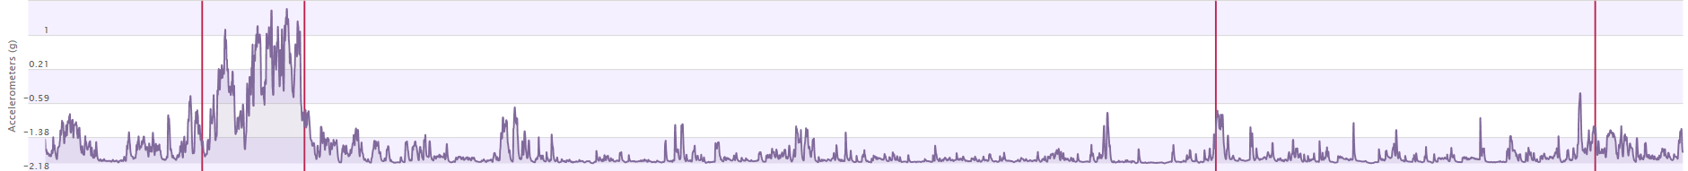
Data quality check: real life test (5), session 2
Start breakfast
Start meetings at CMU
Start lunch
Start biking + school
Start stairs + meeting BBL

Slide 23
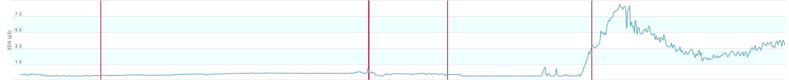
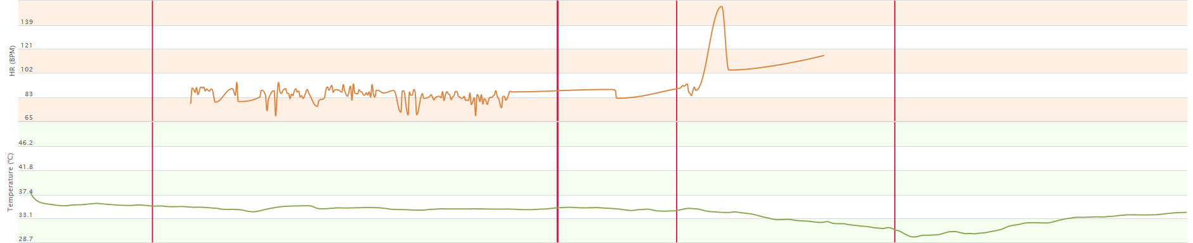
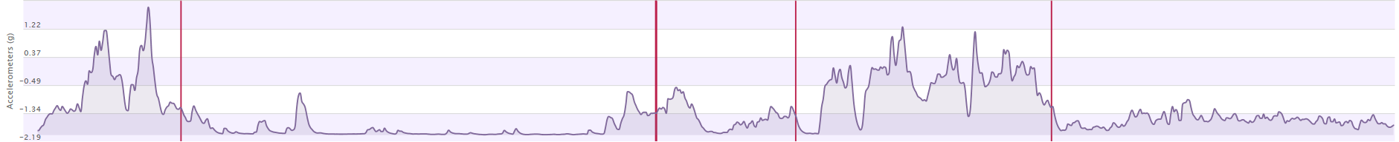
Data quality check: real life test (6), session 3
Start biking
Start meeting
Start shopping, garden, carrying things
Start biking

Slide 24
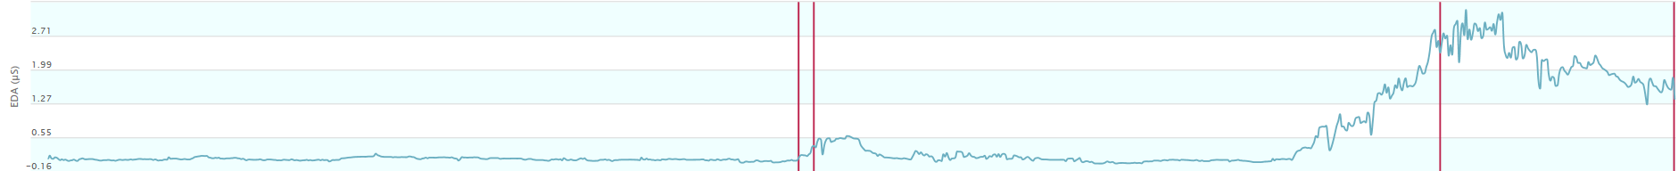
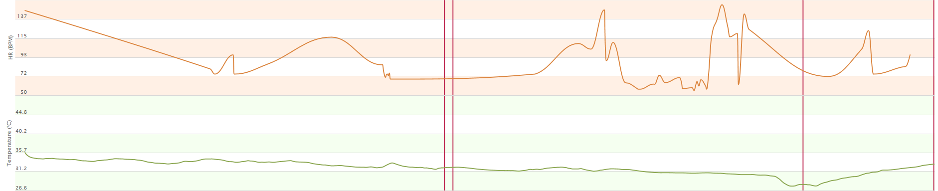
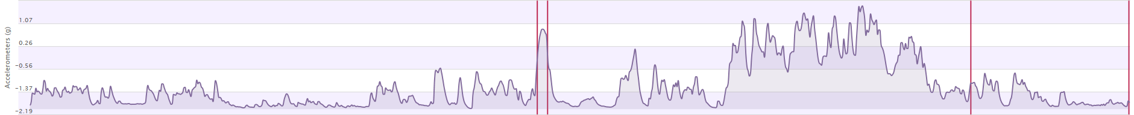
Data quality check: real life test (7), session 4
Start clean up and reading
Start rest (8 minutes) + biking to CMU
Start jumping
Arrival at CMU

Slide 25
Conclusions (1)
Heart rate is reliable
Temperature is reliable
Measure of acceleration allows capturing only large and slow movements or fast movements
Skin conductance: although empatica has conducted a successful test when comparing the e4 (exactly e3) with a biopac like device, they made the comparison on fingers but when testing with the wrist, it does not capture the SCR response in almost all participants
Skin conductance must be checked with online before starting the recording (deep breath check): many participants might not exhibit any response
Acceleration sensor cannot remove reliably the contribution of movements to the physiological signals (but better than nothing)
There might be a substantial variability between devices
Analyses of all signals should remove a substantial window before and after each trigger to prevent biases due to artefacts
A solution has been set to trigger events without using the button of the device (but the investigator must be there)
Analyses of signals can be performed with Acknowledge thanks to a home made matlab function for converting all files

Slide 26
Conclusions (2)
E4 devices must be used only when no other solution based on Biopac (cables) or Bionomadix (wifi Biopac) cannot be set.

